Slide 1
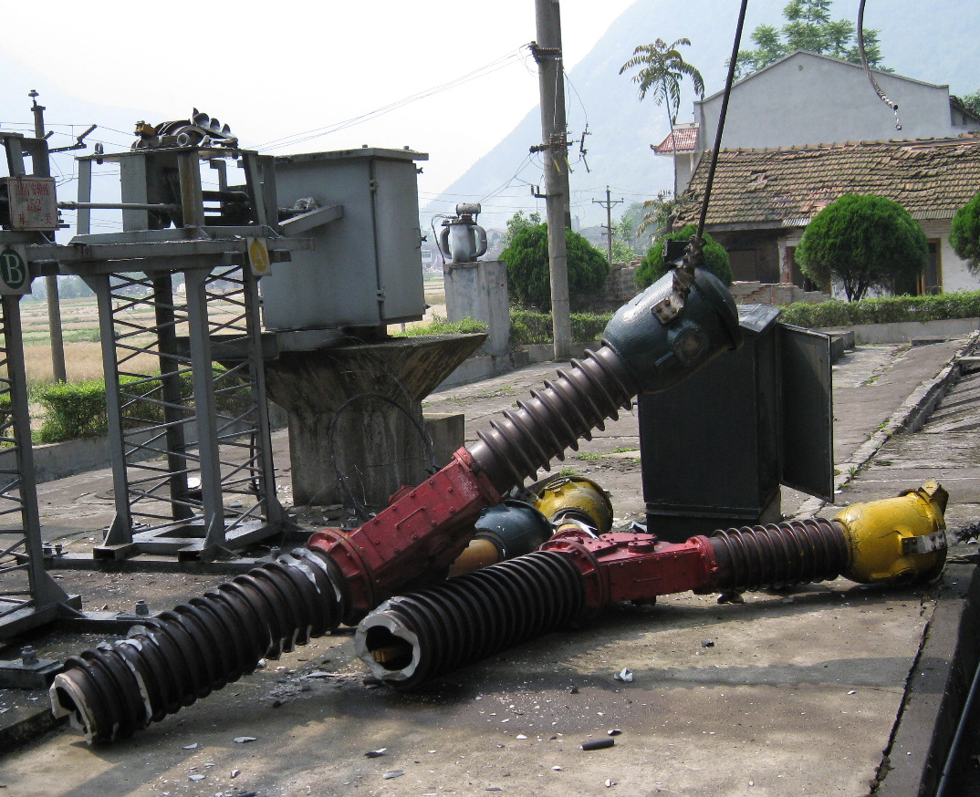
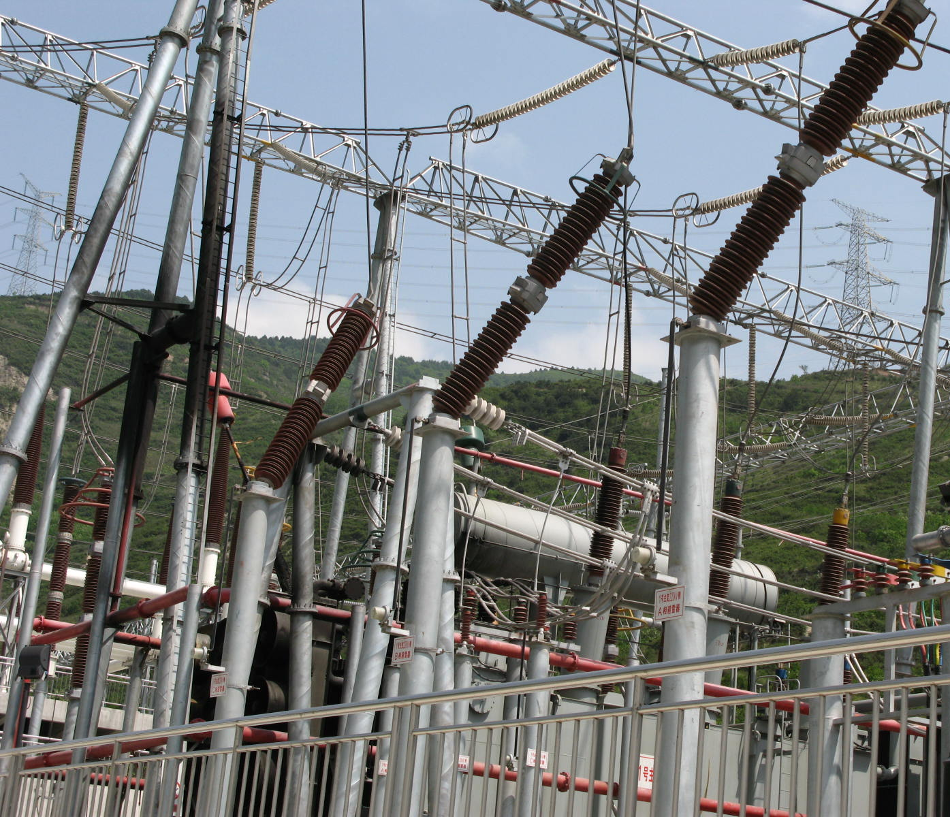
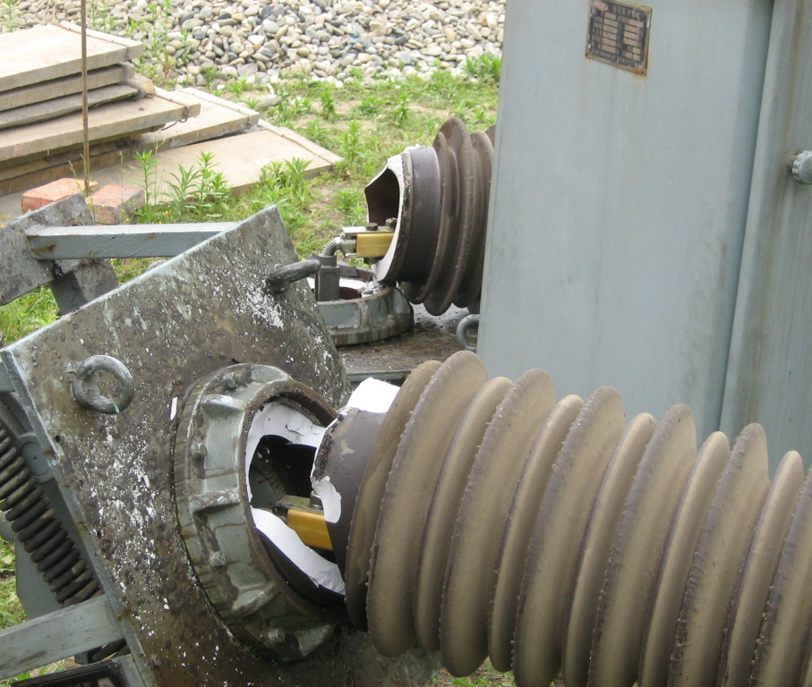

Slide 2
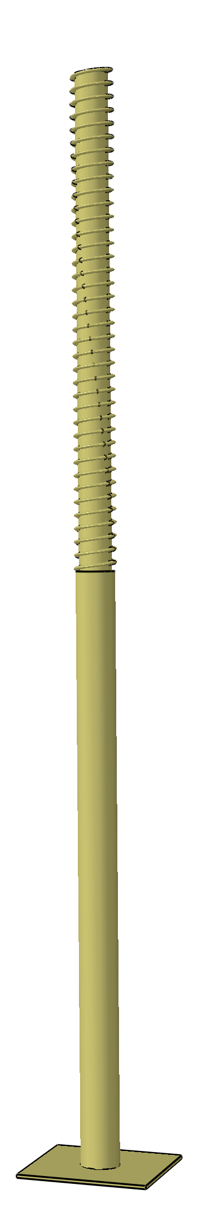
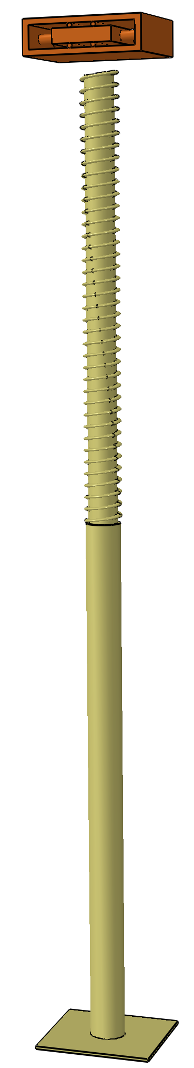
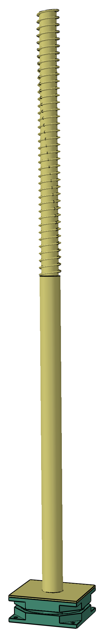
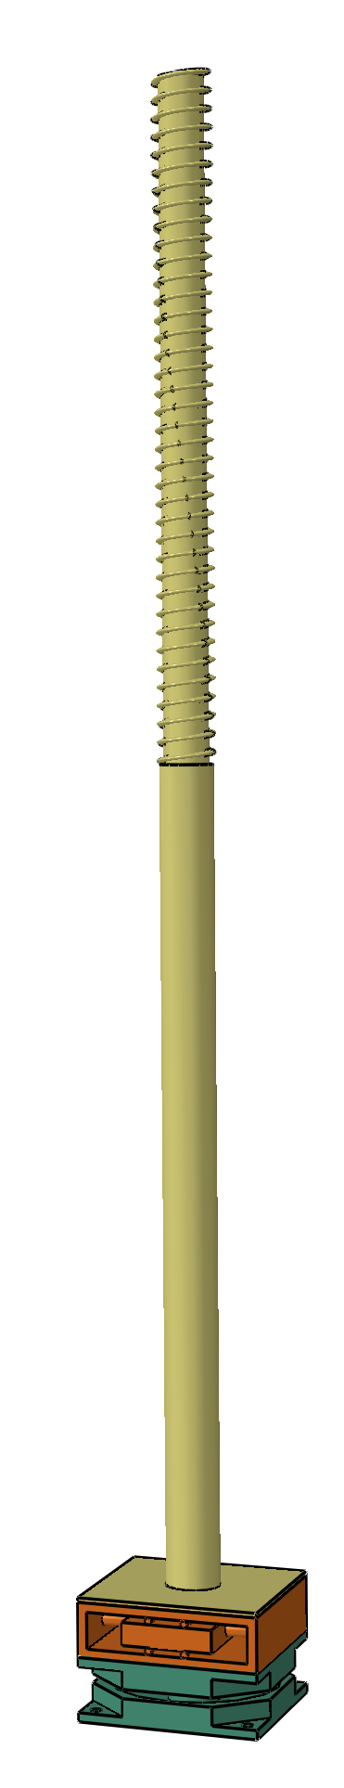
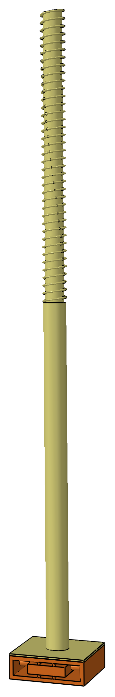
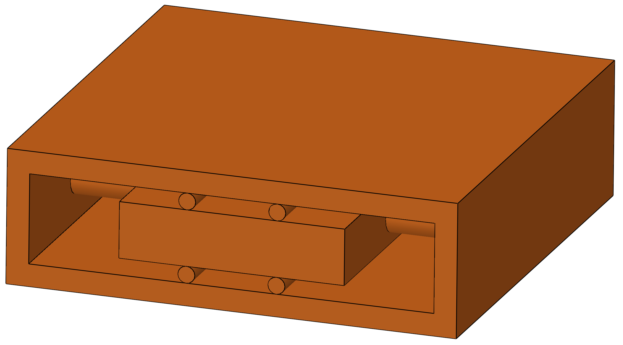
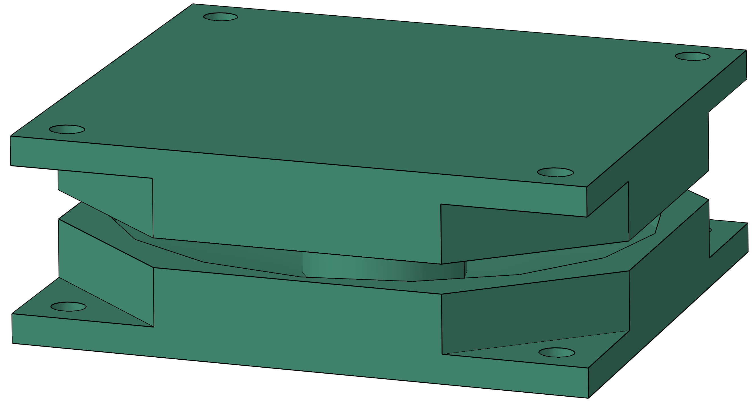
Conductors
Conductors
TMD
Conductors
Conductors
Conductors
Conductors
PCEE
PCEE
PCEE
PCEE
PCEE
PCEE
TMD
(Schematic)
BI
(Schematic)
Support
Support
Support
Install
Install
BI
(a) PCEE
(b) BI only
(c) TMD only
(d) Proposed BI-TMD (Schematic installation position)

Slide 3
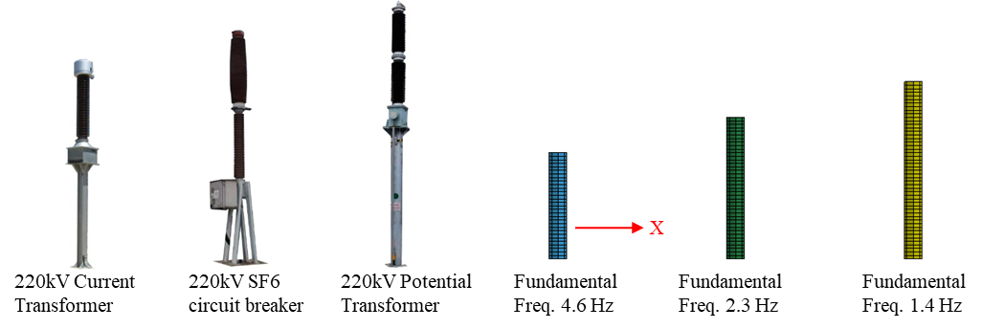
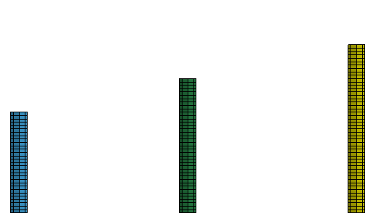
Given three frequency values:
4.6 Hz, 2.3 Hz and 1.4 Hz
Regarded as an overall structure
f₁=4.6 Hz
f₁=2.3 Hz
f₁=1.4 Hz
f₁
220kV Current Transformer
220kV SF6 circuit breaker
220kV Potential Transformer
Simplified overall model
Equipment 1
Equipment 2
Equipment 3
(a) Representative PCEEs
(b) Simplified model
(c) Given frequencies for the simplified model

Slide 4
Ground motion
PCEE
Sub-BI
Period
Sub-TMD
Mass ratio
Sub-TMD
frequency
Chichi
4.6 Hz
1.5 s
50 %
0.50 f_{BI}
……
2.3 Hz
2.5 s
100%
0.75 f_{BI}
Kobe
1.4 Hz
3.5 s
200%
1.00 f_{BI}

